Slide 1


MOBILE PHONE PRICING
Mobile Phone
Price Prediction
Feature engineering, exploratory analysis and machine-learning valuation of Indian retail handset listings
Dataset Processed_Flipdata.xlsx · 531 listings × 11 raw fields 428 / 103 train-test split
By: Srishti Sharma

Slide 2
Price Is Substantially Spec-Driven
Below the Flagship Tier
A tuned Random Forest explains roughly 69% of price variation from device specifications alone. Brand adds little independent pricing power once specifications are known — except at the flagship tier, where a premium attaches to Apple and Google on a thin sample.
531
Listings analysed (post-dedup)
0.751
Held-out test R²
0.688
Grouped-CV mean R² (0.582–0.769)
₹3,206
Test MAE vs. ₹7,040 naive
68.4%
Importance from top three specs
WHAT THE ANALYSIS ESTABLISES
WHAT FOLLOWS FOR PRICING STRATEGY
Specifications dominate brand
Memory (r=+0.564), RAM (r=+0.529) and camera specifications carry the pricing signal; brand contributes marginal independent power once specs are fixed.
Two masked relationships recovered
Battery capacity and screen size showed misleading correlations until a 15-listing data-quality cluster was isolated and handled.
Front-camera MP is the sharper lever
≈₹620 per megapixel versus ≈₹139 for rear camera, where 48% of listings cluster at 50MP.
Compete on spec-per-rupee below flagship
Where brand equity is not priced in, incremental Memory and RAM are the highest-yield specification investments.
Do not double-count Brand and Chipset
The two are largely the same signal (Cramér's V=0.699, sparse cells); adjusting price for both risks double-counting.
Deploy as a sanity tool, not a pricing engine
Pilot internally with mandatory manual review; a 10-field lite model retains 97.5% of CV R² for field use.
Source: Processed_Flipdata.xlsx (541 raw listings; 531 post-deduplication); Test-set figures reflect a single held-out split (seed=42) and carry mild selection optimism

Slide 3
Four-Stage Workstream From
Raw Export to Pricing Guidance
Price in this dataset is market-set rather than formula-derived. The objective is to establish which specifications are associated with price, and by how much, while remaining explicit about what the evidence can and cannot support.
01
Clean & Engineer
Resolve mislabeled columns, text-encoded specifications and unit inconsistencies; construct modelling-ready features.
02
Analyse
Univariate, bivariate and multivariate structure, with effect sizes and significance testing throughout.
03
Model
Nine regression algorithms benchmarked against a naive baseline under group-aware cross-validation.
04
Recommend
Translate findings into pricing and product-strategy guidance, with limitations disclosed.
531
Listings after de-duplication
42
Model features after encoding
9
Algorithms benchmarked
187
Unique handset models

Slide 4
The Source Export Required
Substantive Remediation
Three material defects were identified and resolved before analysis, alongside one defensive load-time safeguard. Nothing was silently dropped; the flagged cluster was retained and carried into the model as an explicit feature.
DEFECTS RESOLVED, AND ONE SAFEGUARD
POST-CLEANING POSITION
Mislabeled screen-size column
"Mobile Height" stored a subset of rows in inches, mixed with centimeters — traced and converted to a consistent scale rather than dropped.
Text-encoded camera specifications
"50MP" / "8MP" strings cast to numeric; ambiguous 0MP entries treated as missing and imputed on training-derived brand medians, not read as zero.
Flagged data-quality cluster
15 listings (2.8%) sharing a garbled unit pattern — retained and flagged rather than deleted, and tracked through every downstream stage.
Safeguard — target column name drift
Source exports have used both "Price" and "Prize" across runs; handled defensively at load time. A precaution, not a defect in this export.
Metric Value
Total listings
Duplicate listings removed
Raw → engineered columns
Missing values post-clean
Camera MP imputation basis
Price range
Average / median price
Flagged-cluster avg. price
541 raw → 531 clean
10 exact (first retained)
12 → 23 (11 post index-drop)
0 nulls
Brand median (train-derived)
₹920 – ₹80,999
₹16,306 / ₹13,999
₹1,851 vs. ₹16,726 rest

Slide 5
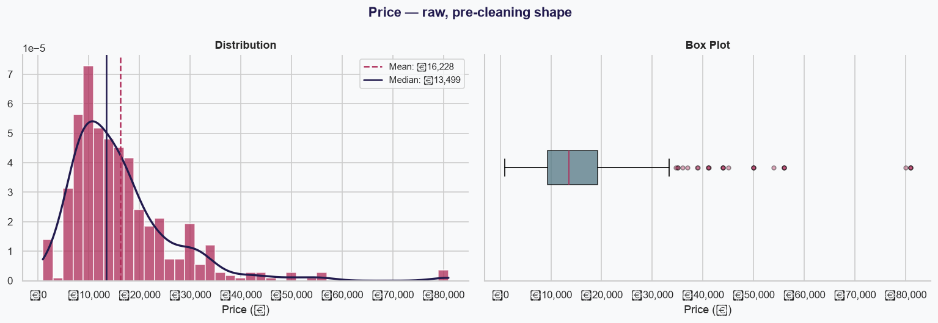
Target Price Distribution
Mobile prices are strongly right-skewed, with most listings concentrated in the budget and mid-range segments.

Slide 6
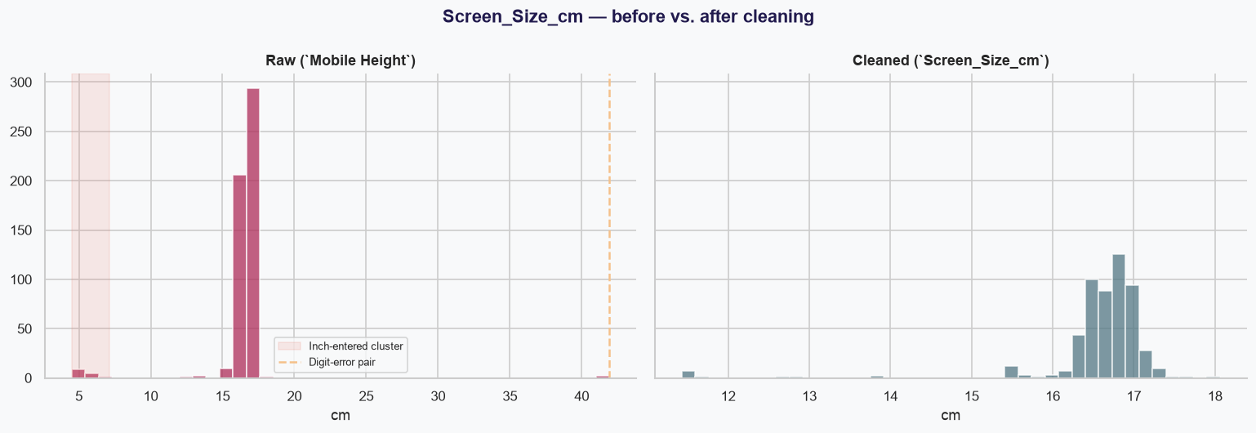
Screen-Size Correction
Mixed inch and centimetre values were standardised to centimetres before analysis.

Slide 7
Six Derived Features Convert Raw Specifications Into Modelling Inputs
Brand –
First token of the model-name string, with typo and alias correction (e.g. "I" → IKALL).
Base_Colour –
15 keyword-matched colour families; buckets below 10 observations folded into "Other”.
Processor_Brand –
Chipset text mapped to Qualcomm, MediaTek, Exynos, Unisoc, Google or Apple.
Is_5G –
Boolean flag parsed from the model-name string.
Total_Camera_MP –
Rear and front megapixels combined into a single camera-capability signal.
is_flagged_dq
Data-quality cluster membership carried through as a genuine model feature, not discarded.
Final model feature set: 6 numeric + 5 categorical (one-hot encoded) → 42 columns entering the model

Slide 8
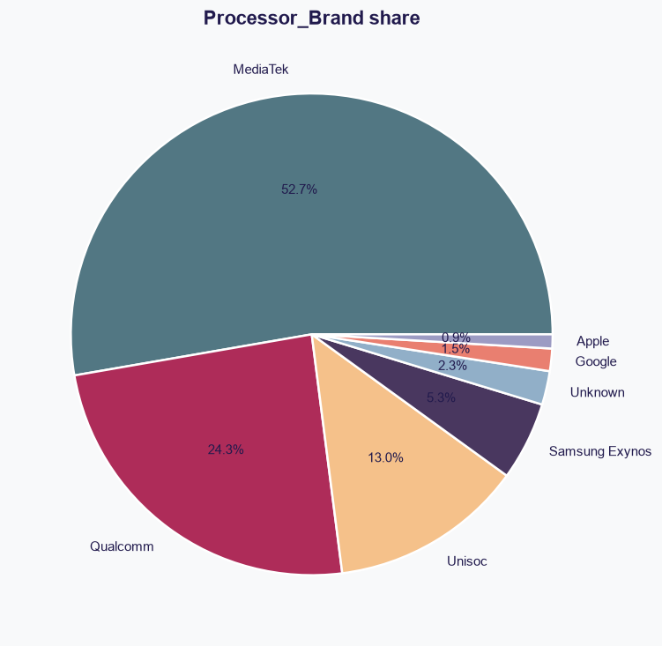
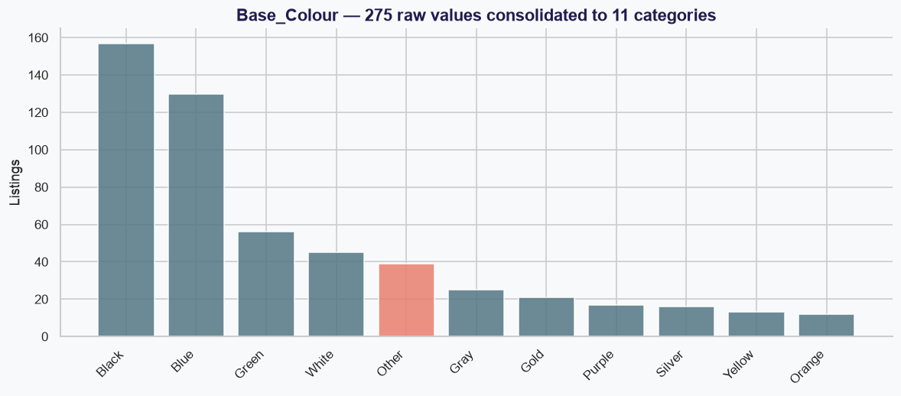
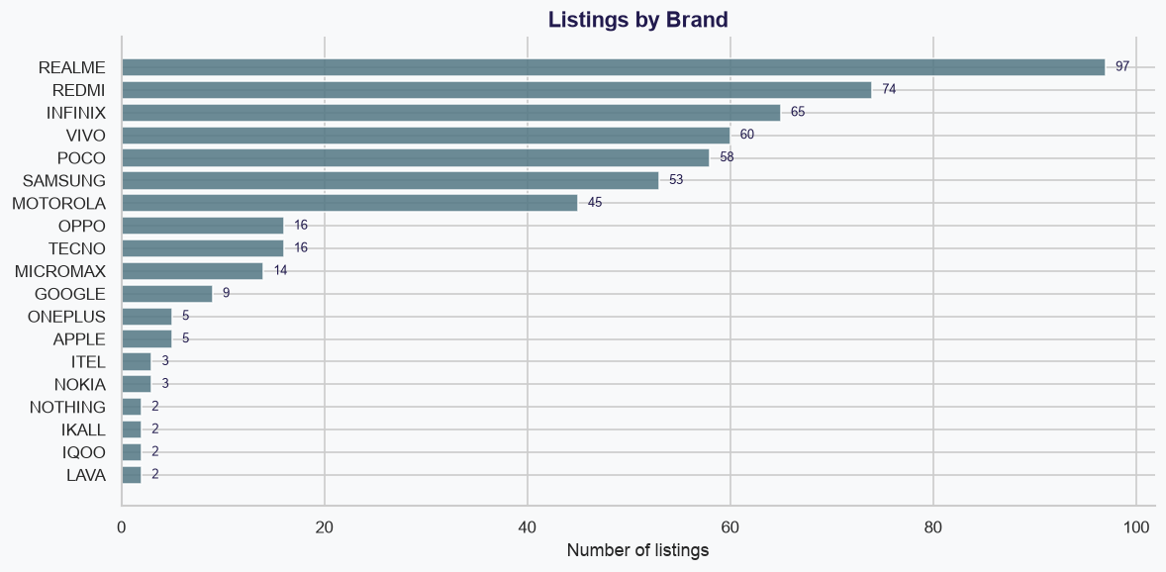
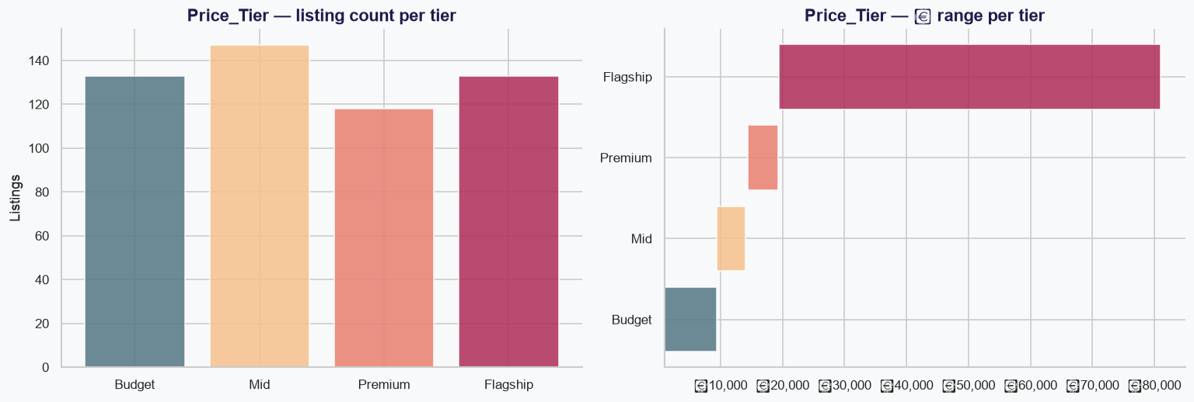
Feature Distribution
Final model feature set: 6 numeric + 5 categorical (one-hot encoded) → 42 columns entering the model

Slide 9
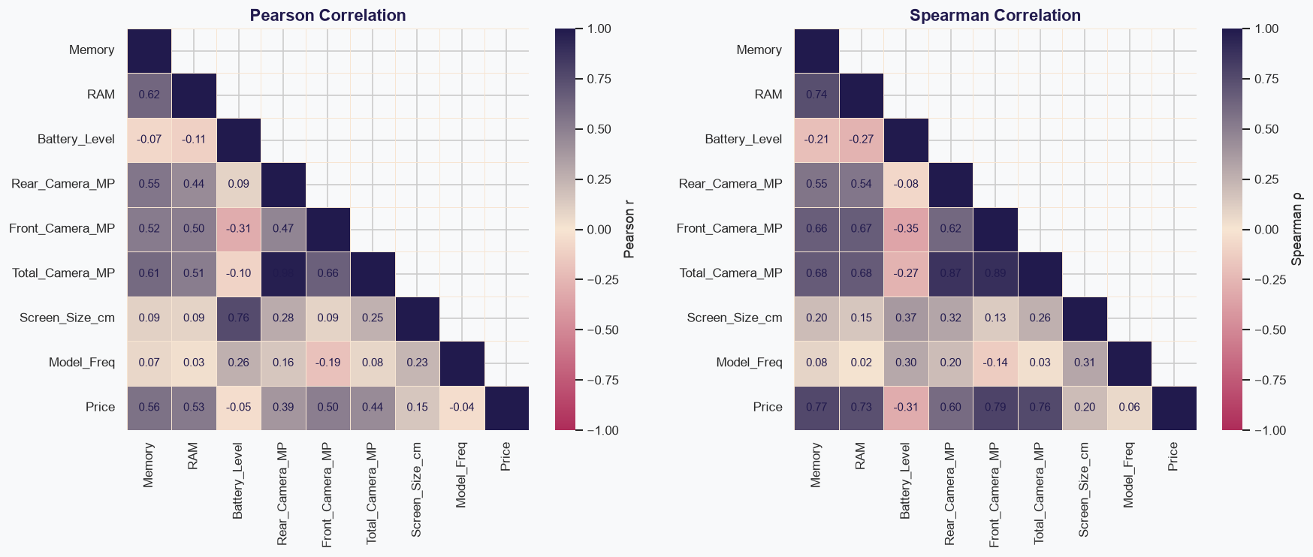
Numerical Correlation Analysis
Memory, RAM and Front Camera MP show the strongest positive relationships with price, while the flagged cluster distorts Battery and Screen Size correlations.

Slide 10
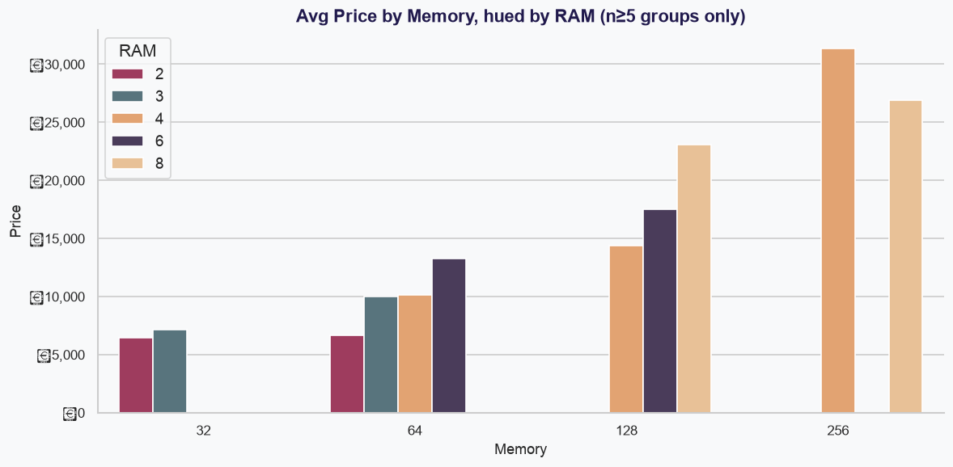
Memory and RAM Lead on
Linear Correlation — But Not Unconditionally
Simple correlations understate front-camera megapixels, whose relationship with price is materially non-linear, and overstate brand, which largely duplicates the chipset signal. RAM and Memory are themselves correlated (r = +0.644), so RAM adds little once Memory is in the model.
WHAT THE DEEPER ANALYSIS FOUND
Memory and RAM are the strongest linear predictors, but interact sub-additively — the interaction is statistically confirmed (p = 0.017).
Front-camera megapixels are materially non-linear; their rank rises sharply once multivariate structure is accounted for.
Brand appears dominant in isolation (ε² = 0.366) but is effectively tied with chipset (ε² = 0.368) — one signal, not two levers.
Battery level and screen size showed masked relationships that only resolved once the 15-listing flagged cluster was handled.
Pearson correlations on the full 531-listing dataset. Effect sizes are ε² from Kruskal-Wallis, not η² from ANOVA: both Brand and Processor_Brand fail Levene's test for equality of variance, so the ANOVA-based statistic is not valid here. Correlations are associations, not causal effects.

Slide 11
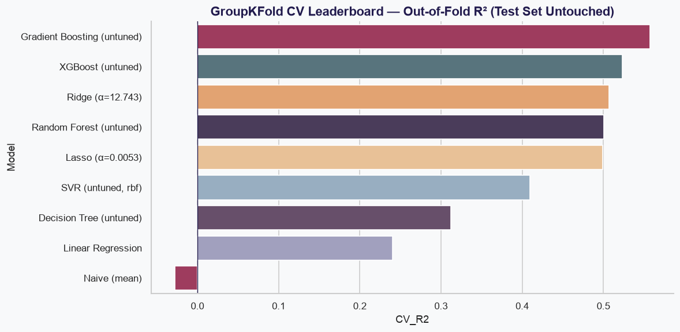
Nine Algorithms Benchmarked
Under Group-Aware Cross-Validation
Model selection ran entirely on GroupKFold cross-validation, which ensures the same handset model never appears in both training and validation folds. The test set was touched once, for the top three CV finalists, to confirm the choice rather than to make it.
Why XGBoost led cross-validation but Random Forest was retained
XGBoost led the tuned CV ranking (R² = 0.612 vs. 0.590), but that lead did not hold on the held-out split, where it was the weakest of the three finalists.
The tuned Random Forest achieved the highest held-out test R² (0.751) and was retained.
The Decision Tree is the cautionary case: it ranked first on a single random split (R² = 0.745) but eighth of nine under grouped CV (0.365) — the clearest evidence that a single split cannot carry the ranking.
Untuned five-fold GroupKFold cross-validation, grouped on handset model; Ridge and Lasso shown at CV-selected α. Naive benchmark is the training-mean predictor. SVR reached CV R² = 0.534 after tuning but ranked fourth and so never touched the test set.

Slide 12
Random Forest (Tuned):
Report the Range, Not the Single Split
At n = 531 a single train/test split is a fragile basis for a headline figure. Two independent stability checks place the defensible expectation at R² ≈ 0.58–0.69, with the reported 0.751 sitting near the favourable end.
15 / 531
Listings flagged (2.82% of dataset)
4.6%
Share of total model error contributed
4.6×
Error over-representation vs. cluster size
₹1,851
Cluster average price vs. ₹16,726 rest
BEST CV SCORE PER MODEL, AND HELD-OUT CONFIRMATION
Test-set protocol
Selection was made on CV alone; the test set was touched once, for the top three finalists. It was subsequently reused for residual and permutation diagnostics, so comparisons of the alternative techniques on test are directional rather than independent.
Full metric suite: R² 0.7507 · MAE ₹3,206 · RMSE ₹5,548 · MAPE 19.67%. Hyperparameters: max_depth 15, min_samples_leaf 2, n_estimators 500.
Model | CV R² (GroupKFold) | Test R² | Test MAE | Status
Naive (Mean Predictor) | (0.028) | (0.000) | ₹7,040 | Floor
Linear Regression | 0.374 | 0.511 | ₹3,499 | Untuned Baseline
Lasso (Best Linear Model) | 0.499 | 0.688 | ₹2,743 | Best Interpretable Model
XGBoost (tuned) | 0.612 | 0.644 | ₹3,337 | CV leader, test laggard
Gradient Boosting (Tuned) | 0.595 | 0.723 | ₹2,968 | Runner-Up (Best MAE)
Random Forest (Tuned) | 0.590 | 0.751 | ₹3,206 | ★ Final Model
CV R² is the model's best five-fold GroupKFold score (untuned for Linear and Lasso, tuned for the ensembles); test figures come from the single 428 / 103 held-out split at seed 42. The two are computed on different samples and are not directly comparable. Figures in parentheses denote negative values.

Slide 13
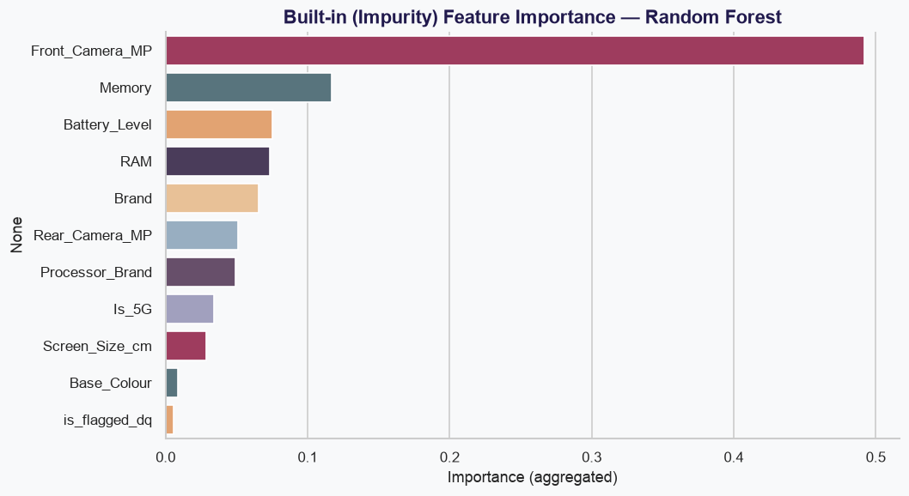
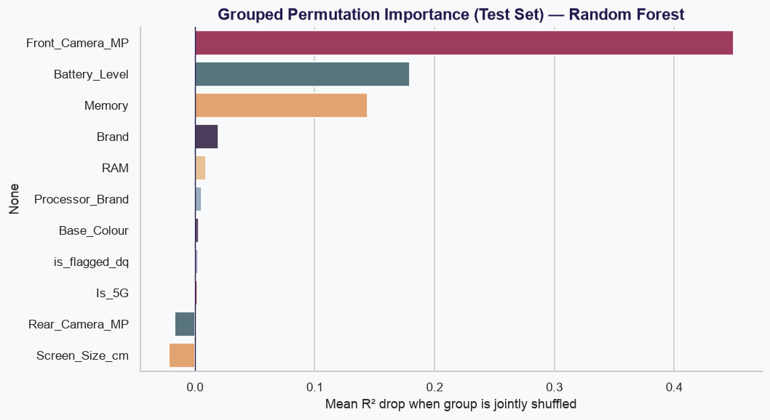
Two Independent Methods,
Triangulated Rather Than Trusted Alone
Read the confounding, not just the ranking
Front_Camera_MP tops both rankings, but its impurity score (0.492) is partly inflated: all five Apple rows in the training subset share Front_Camera_MP = 12, confounding the feature with the highest-priced brand. The permutation check — run on a test set containing zero Apple rows — confirms the signal survives, but the two methods use different samples, and both are triangulated against SHAP rather than relied on individually.
Impurity importance from the tuned Random Forest fitted on the 428-row training subset; permutation importance measured on the held-out test split. The two are computed on different samples and are not directly comparable in magnitude.

Slide 14
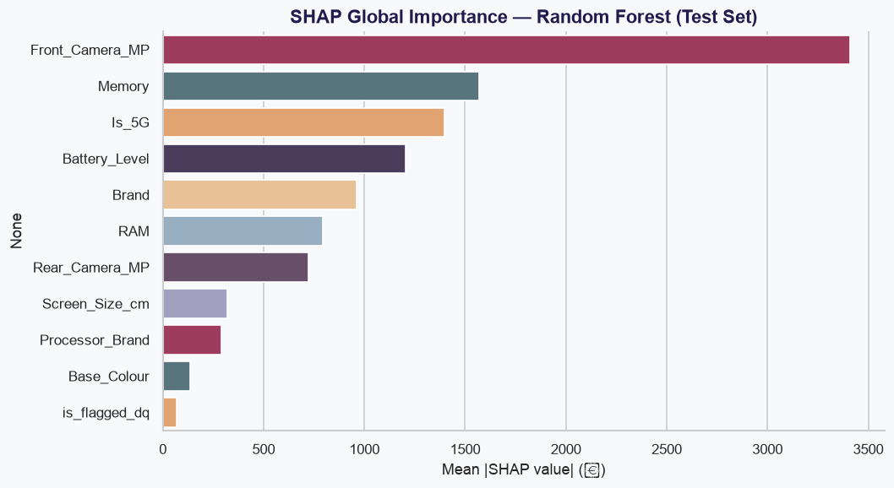
SHAP Global Interpretation
SHAP provides a third importance check and confirms Front Camera MP and Memory as major drivers of individual predictions.

Slide 15
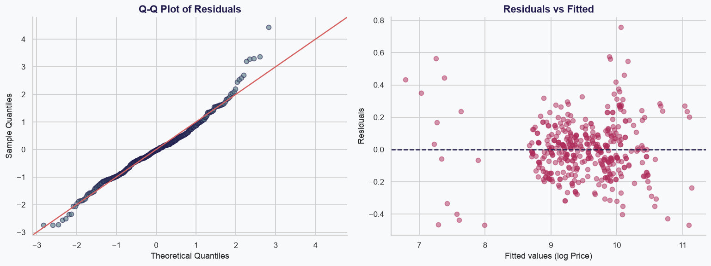
Residual Diagnostics
Residual spread increases at higher fitted values, showing that prediction uncertainty grows with price.

Slide 16
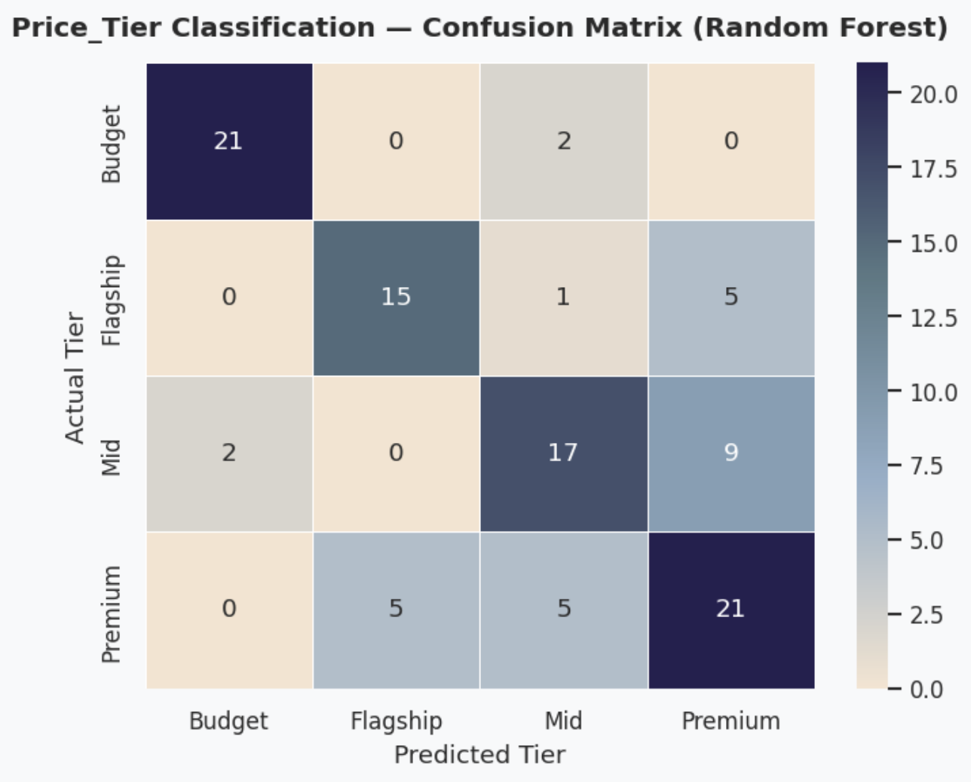
Price-Tier Classification Performance
The classifier achieves 72.8% accuracy, identifying Budget phones most reliably while showing greater confusion between Mid and Premium tiers.

Slide 17
Uncertainty Is Surfaced
Alongside Every Prediction, Not Behind It
WORKED EXAMPLE
CONFIDENCE SIGNALS SHOWN PER PREDICTION
128GB / 6GB RAM · 5,000mAh · 64MP rear / 16MP front 16.7cm screen · Realme · MediaTek · 5G
₹19,993
Model point estimate
₹16,786 – ₹23,199
Illustrative global error reference (point estimate ± held-out MAE of ₹3,206). This is not a calibrated prediction interval and should not be quoted as one.
Tree-disagreement range
5th–95th percentile spread of predictions across the forest's individual trees.
Low-support warnings
Brand, Memory × RAM and Brand × Processor combinations below sample thresholds are flagged at the point of use.
Range check
Inputs falling outside the observed training range are called out explicitly rather than extrapolated silently.
Flagged-cluster caution
A dedicated warning where a device resembles the hardest-to-predict segment identified on p. 10.

Slide 18
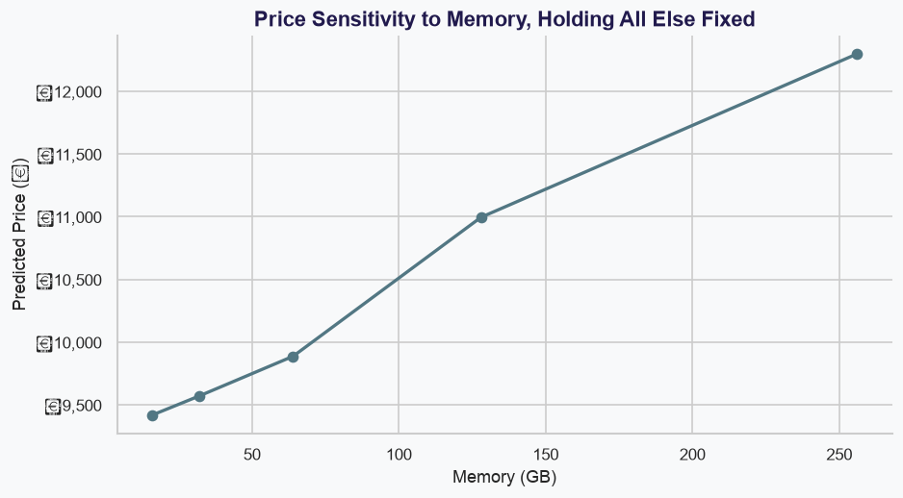
Memory Sensitivity Analysis
Predicted price generally increases with Memory, but the size of the increase depends on the device’s other specifications.

Slide 19
Eleven Questions,
Answered From the Evidence
Q1. Specifications account for 68.4% of impurity-based importance; brand's marginal contribution once specs are known is 0.020.
Q2. Among 128GB+ devices, Apple averages 3.47× Samsung and 4.68× Realme — on three Apple listings, so directional only.
Q3. Memory × RAM interact sub-additively; the interaction is statistically confirmed (coefficient −0.0246, p = 0.017).
Q4. Budget separates cleanly (F1 = 0.91); Flagship 0.73, Premium 0.66 and Mid 0.65 are materially less distinct.
Q5. Qualcomm devices average ₹20,777 against MediaTek's ₹14,738 — 41.0% higher, but confounded with brand mix.
Q6. The flagged cluster is ~1% of test rows but drives 4.6% of total absolute model error.
Q7. Front camera carries ≈₹620/MP against ≈₹139/MP for the rear camera, where 257 of 531 listings ship 50MP.
Q8. A 10-feature lite model retains 97.5% of cross-validated R²; the 0.017 gap sits inside the model's own 0.073 fold-to-fold noise.
Q9. Worked example returns a ₹19,993 point estimate within a ₹16,786–₹23,199 illustrative range.
Q10. The ceteris-paribus 5G simulation gives 41.0% (range 18.2–64.5%) — a modelled response, not a causal market effect.
Q11. Synthesis — specifications carry most of the predictive information overall, while brand-level differences remain visible in the higher-priced subsets. Developed on the following page.
All relationships reported are statistical associations, not established causal effects; findings resting on fewer than ten observations are flagged as directional.

Slide 20
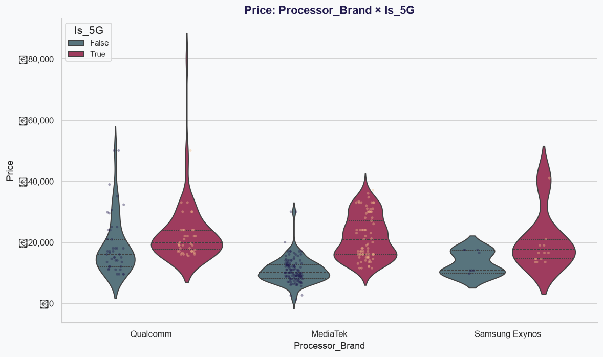
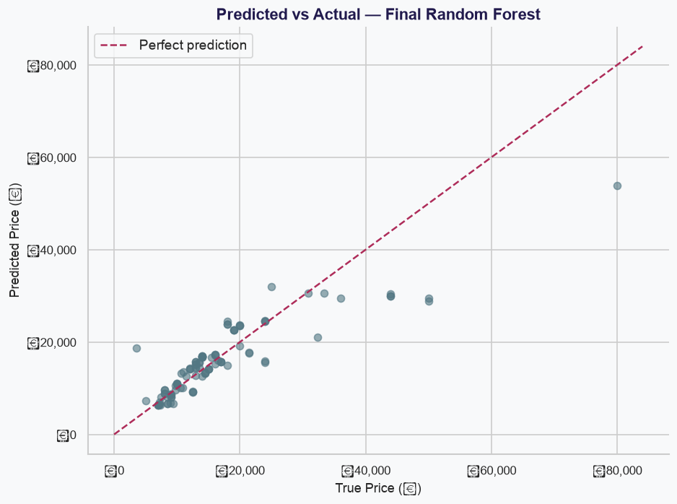
Visual Evidence Behind the Key Questions
Main Price Drivers
Processor and 5G Differences
Model Validation: Predicted vs Actual
Memory–RAM Joint Effect
All relationships reported are statistical associations, not established causal effects; findings resting on fewer than ten observations are flagged as directional.

Slide 21
A 15-Listing Cluster Drives a
Disproportionate Share of Model Error
Representing 2.8% of listings, the flagged cluster contributes 4.6% of total model error — a 4.6× over-representation relative to its share of test rows.
15 / 531
Listings flagged (2.82% of dataset)
4.6%
Share of total model error contributed
4.6×
Error over-representation vs. cluster size
₹1,851
Cluster average price vs. ₹16,726 rest
HOW THE CLUSTER WAS HANDLED
1
2
3
4
Detected
Screen-size entries stored in inconsistent units — a mix of inches and centimetres — identified during quality checks.
Corrected
Values converted to a consistent centimetre scale rather than dropped, averaged away or winsorised.
Flagged, not hidden
A permanent is_flagged_dq feature carries the cluster's identity into the trained model as a genuine input.
Monitored downstream
Traced through outlier detection, correlation and residual analysis as the model's hardest segment.
Error contribution measured on the held-out test split; cluster represents approximately 1% of test rows.

Slide 22
Two Pricing Regimes Coexist —
and They Require Different Playbooks
The market does not price uniformly. Below the flagship tier, specifications set price. At the flagship tier, brand equity does — and specification improvements alone will not close the gap.
Below the flagship tier
THE LARGE MAJORITY OF THE MARKET
Prediction performance is stronger and errors are less concentrated. Storage, RAM and camera specifications explain most of the price variation, and brand carries little independent pricing power once specifications are fixed. The top three specifications alone account for 68.4% of the model's impurity-based importance.
At the flagship tier
APPLE N = 5, GOOGLE N = 9 — DIRECTIONAL ONLY
A price premium attaches to Apple and Google that specifications alone do not explain, though samples of five and nine listings make this directional rather than a precise multiplier. The model's largest errors concentrate here: it underprices the Galaxy S23 5G by 32.8% and the Motorola Edge 30 Ultra by 42.3%. Absolute error correlates with true price at r = 0.818.
Strategy: compete on spec-per-rupee value.
Hypothesis: closing the gap plausibly requires brand-equity investment, not specification increments.
Flagship-tier findings rest on brand samples of five (Apple) and nine (Google) listings across the full dataset, and three Apple listings within the 128GB+ subset; all should be read as directional. Error figures from held-out test residuals, Section 9B.

Slide 23
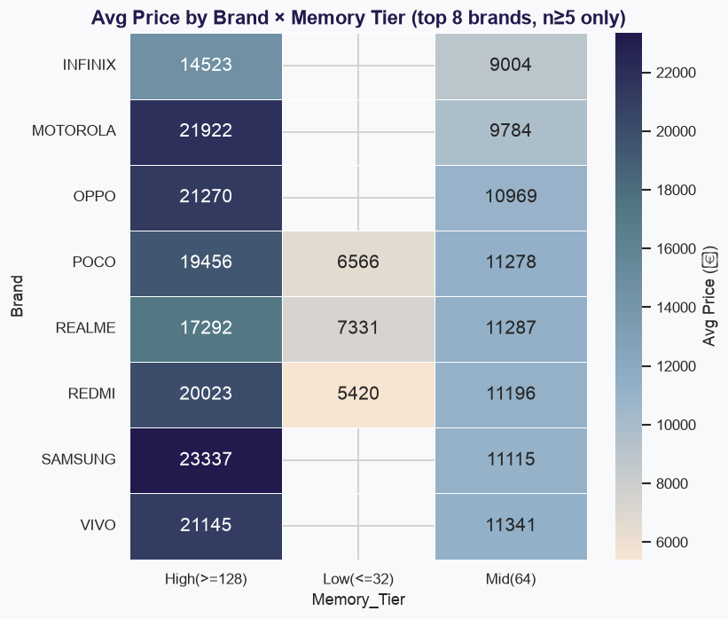
Two Pricing Regimes
Phone pricing follows two distinct patterns: specifications drive value below the flagship tier, while brand premium becomes more influential at the flagship level.

Slide 24
Prioritized Actions for
Pricing and Product Strategy
High Priority
Price on specifications, not brand alone. Memory, RAM and camera features consistently carry substantial predictive signal; brand adds only marginal independent signal once specifications are known.
Prioritise accurate Memory and RAM capture in any pricing tool — these are the two fields with the greatest estimated price association per unit of input.
Do not treat Brand and Chipset as independent levers. Their categorical association is strong (Cramér's V = 0.699, sparse contingency table, directional only); adjusting for both risks double-counting one signal.
Treat any "5G adds X%" figure as a scenario estimate specific to device and segment, not a constant. The ceteris-paribus simulation gives 41.0% (range 18.2–64.5%) against a raw REDMI lineup comparison of +134%, which conflates 5G with every other spec difference between those lineups.
Medium Priority
Low Priority
Pilot the 10-field lite pricing tool internally, with manual review, for field-sales and retail-partner quoting where full specification entry is impractical — it retains 97.5% of mean CV R² at modest MAE cost.
Treat the tuned Random Forest as a prototype pricing-sanity tool piloted internally with manual review before any production use. PCA and stacking were tested and do not earn their complexity at this dataset size.

Slide 25
Limitations of the Analysis
Statistical power
At n = 531 the analysis detects effects down to |r| ≈ 0.12 or d ≈ 0.24. Below that, and for brands with as few as two listings, a null result is inconclusive rather than evidence of no effect.
Test-set reuse
Selection ran on CV alone, but the test set was reused for diagnostics after confirmation, so post-selection test comparisons are directional.
No cost or time-series data
No manufacturing cost, competitor pricing or listing-date data was available in the source export.
Sparse contingency tables
12 of 15 categorical pairs fail the reliability check. The Brand × Chipset association (Cramér's V = 0.699) is directional only.
Split-to-split variance
Repeated splits show genuine R² variance (0.584 ± 0.118) around the single reported 0.751.
Association, not causation
Every relationship reported is an association; price is market-set rather than derived from a known formula.
Manual review required
Flagged data-quality records (2.8%) are low-confidence and require validation before any pricing use.
Not production-ready
Best treated as a prototype pricing-sanity tool piloted internally, not a standalone pricing engine.

Slide 26
Solved to a Defensible Standard;
Two Questions Remain Open
Solved to a defensible standard
Price prediction at test R² = 0.751 (CV-validated at 0.688 mean) using Memory, RAM, camera specifications, Brand and Processor_Brand as the leading drivers. A secondary price-tier classifier reaches 72.8% accuracy against a 22.3% naive baseline.
Two genuine open questions
Cost-adjusted margin modelling requires bill-of-materials data this dataset lacks. Time-series price tracking requires a listing-date field the source export does not contain. Both remain open rather than answered speculatively.
RECOMMENDED NEXT STEPS
Pilot internally
Deploy the model as a pricing-sanity tool with mandatory manual review of every output.
2. Lighten for field use
Adopt the 10-feature lite model for low-friction quoting where full specification entry is impractical.
3. Extend the dataset
Collect listing-date and cost data to unlock margin and time-series analysis.
4. Re-validate as data arrives
Revisit flagged-cluster handling and small-brand samples as the sample base grows.

Slide 27
Thank You!

